Slide 1
NLP Project - Emotion In Text Classifier App
Gandham Sushma
Gandham vishwanadh
Achyutha Gopi
Suresh Gopi

Slide 2
Problem Statement
We want to design and implement the text to emotion system that which is capable of recognizing the emotion and convert it. Here the challenge is to provide the correct emotion for the product or the statement. The design consists of the TEXT PRE-PROCESSING, EMOTION INVESTIGATION, EMOTION ANALYSIS.

Slide 3
Introduction
Emotion is the state of mind that is aligned with feelings, and thoughts usually directed toward a specific object.
Emotion is a behavior that reflects personal significance or opinion regarding the interaction we have with other human beings or related to a certain event. The human being is able to identify the emotions from textual data and can understand the matter of the text.

Slide 4
What is text2emotion
Text2emotion is developed with the clear intension to find the appropriate emotions embedded in the text data.
The research says that when the human is in the thinking process and he is damn sure about his statement then he will express his emotions in the right context of manner and it will be proper aligned in case of words expressing those emotions.

Slide 5
Example
If I want to tell you in simple words then consider if the customer did not like the product by investing the large amount then he will surely give his feedback like “I am very angry by your product services and gonna file a complaint regarding this issue”. When you read this kind of feedback then you will be sure that the customer is completely angry about product services and we have to improve it as soon as possible.

Slide 6
Solution Architecture
Text Area
Application
Orginal
Result

Slide 7
Features
1. TEXT PRE-PROCESSING
At first we have the major goal to perform data cleaning and make the content suitable for emotion analysis.
Remove the unwanted textual part from the message.
Perform the natural language processing techniques.
Bring out the well pre-processed text from the text pre-processing.
There will be keys as emotion categories and values as emotion score.
Higher the score of a particular emotion category, we can conclude that the message belongs to that category.

Slide 8
2. EMOTION INVESTIGATION
Detect emotion from every word that we got from pre-processed text and take a count of it for further analytical process.
Find the appropriate words that express emotions or feelings.
Check the emotion category of each word.
Store the count of emotions relevant to the words found.

Slide 9
3. EMOTION ANALYSIS
After emotion investigation, there is the time of getting the significant output for the textual message we input earlier.
The output will be in the form of dictionary.
There will be keys as emotion categories and values as emotion score.
Higher the score of a particular emotion category, we can conclude that the message belongs to that category.

Slide 10
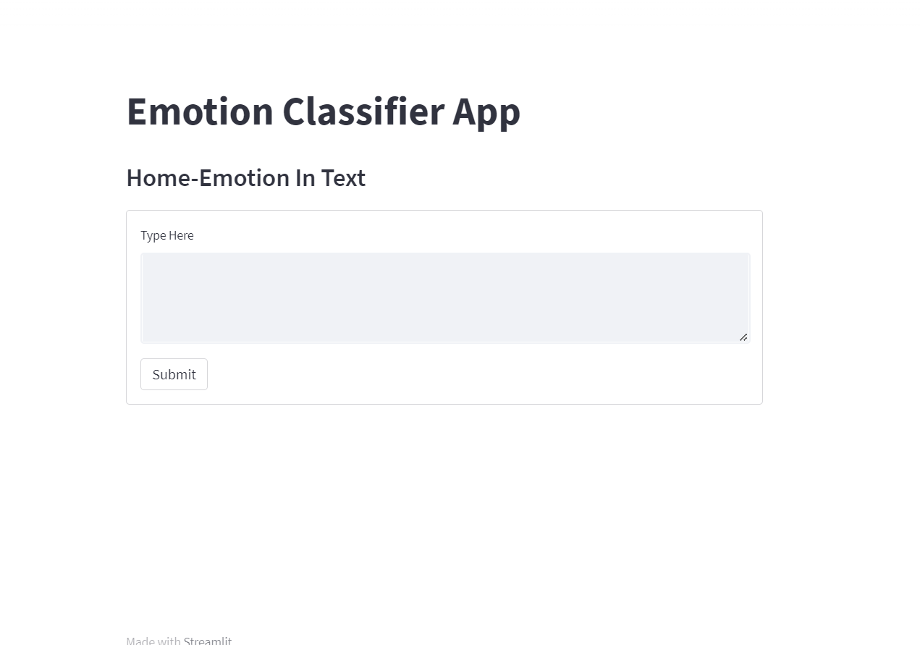
Code and App Explanation
Enter the text in the input box.

Slide 11
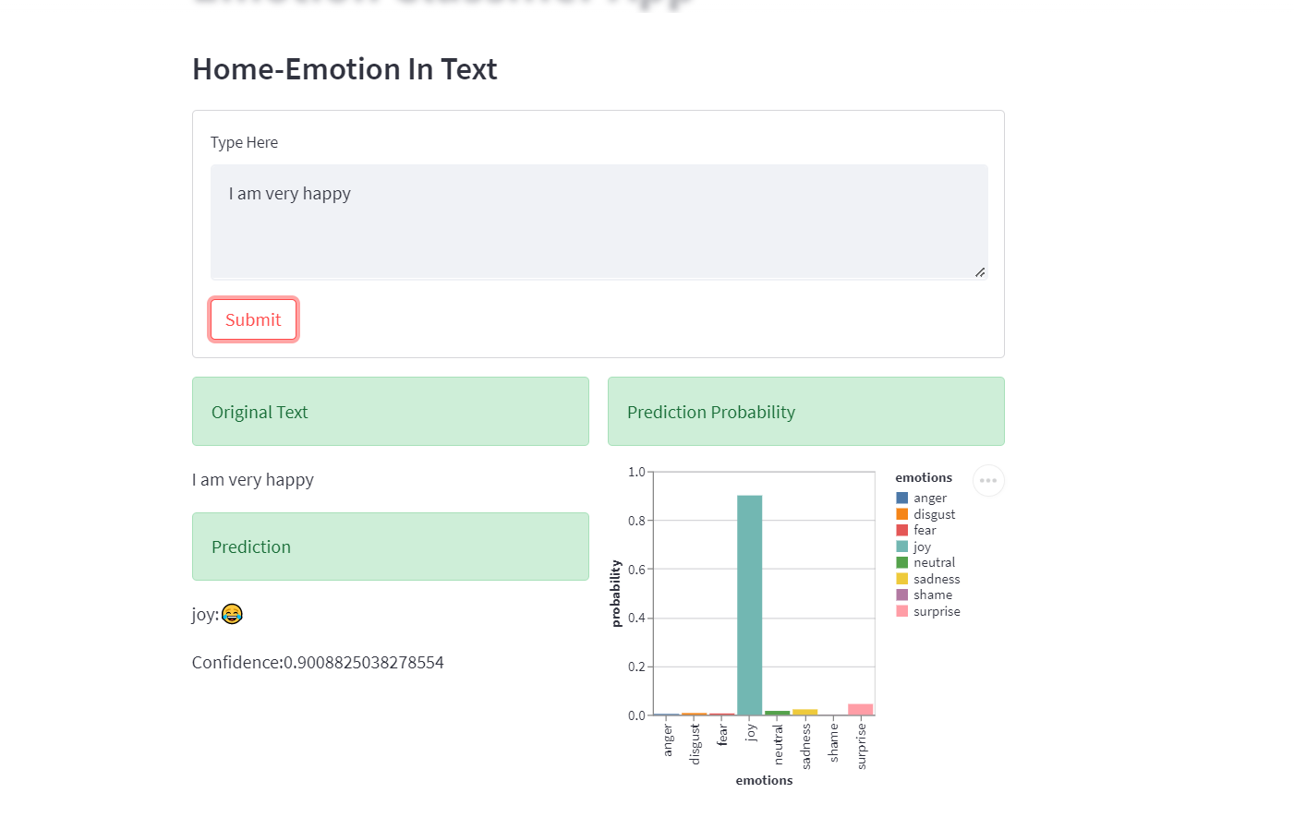
Hit the submit button, We get the output of a chart, Emotion.

Slide 12
Drawbacks and Future Scope
Drawbacks :
It only limits to the words present in the dictionary.
It only consider English word for the prediction
Future Scope:
Multilingual System
Handling all types of emotions

Slide 13
Thank you

